Slide 1

COSE242 : Data Communication
Attendance Verification System
Using Wi-Fi Access Points
Absent Catcher
Team Leader
2020170393 Junhwan Choi
2020190633 Youmin Kim
2021320016 Geon Woo Lim
2021320030 Chanwoo Park
2020130885 Dohun Kim
2020320008 Tae Geon Um
2021320018 Taehee Jeong
2024952875 Tommy Tran

Slide 2


Problem
Problem
#Attendance
Goal
Hard to check
Self-check
Limitation
‘Liberal Attendance’
System improvement
Attendance is important,
But it spends class time
Attendance check is recommended to self-check
Attendance system has
many limitations

Slide 3
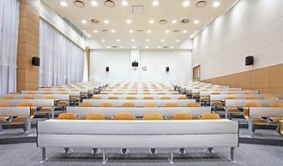





Current Limitations
Current Limitations
Limitations of the current Liberal Attendance system
Do not check the location → Possible to check attendance anywhere
Cannot find out the student who run away during class
Overcome the limitations
Location Checking
Multiple Checking

Slide 4

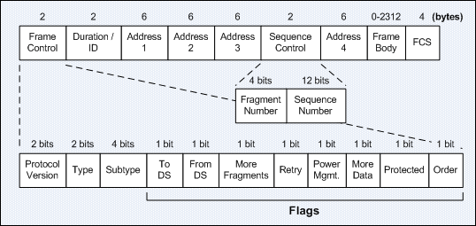
Approach
Approach
#Location #Wi-Fi Access Point
Each Classroom has a Wi-Fi Access Point(AP)
Each Wi-Fi AP has unique MAC address
Mobile devices can receive Wi-Fi protocol packets
→ Wi-Fi AP can be used to check the location

Slide 5
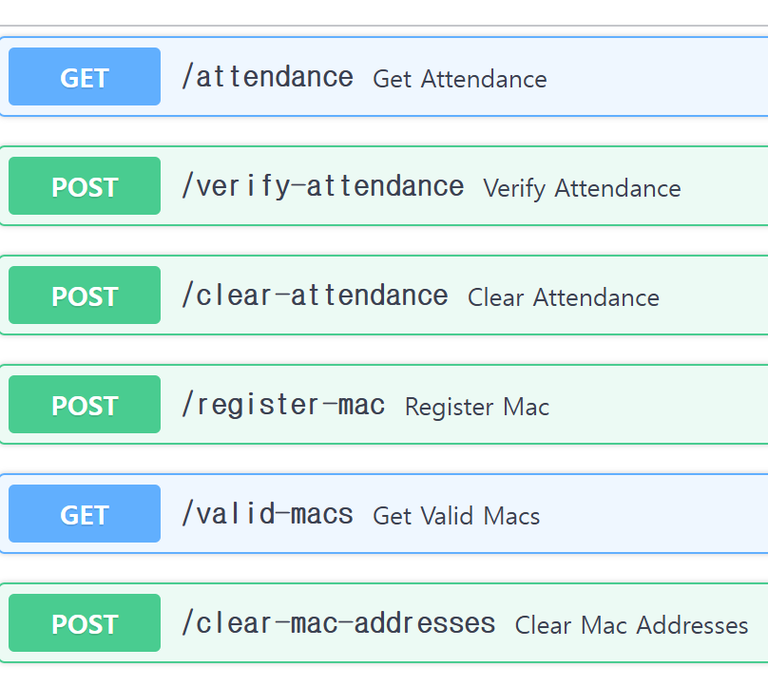
Implementation
Client
Server
def main():
print("=== Attendance Verification System ===")
print("Enter the wanted process:")
print("1. Verify attendance")
print("2. Check attendance list")
process = input(": ")
if process == "1":
student_id = input("Enter student ID: ")
response = requests.get(url=SERVER_URL +\
"/valid-macs",\
headers={'Content-Type': 'application/json’})
result = response.json()
print("\nClassrooms:")
for idx, classroom in \
enumerate(result['classrooms'].keys(), 1):
print(f"- {classroom}")
print() # 가독성을 위한 빈 줄 추가
classroom_id = input("Enter classroom ID (e.g.,\
classroom_1): ")
submit_attendance(student_id, classroom_id)
elif process == "2":
check_attendance_list();
if __name__ == "__main__":
main()
Attendance attempt
(Student ID)
Capture packets
Send to the server
Attendance Verification
(Find valid MAC address)
Send the result
(Success / Failure)

Slide 6
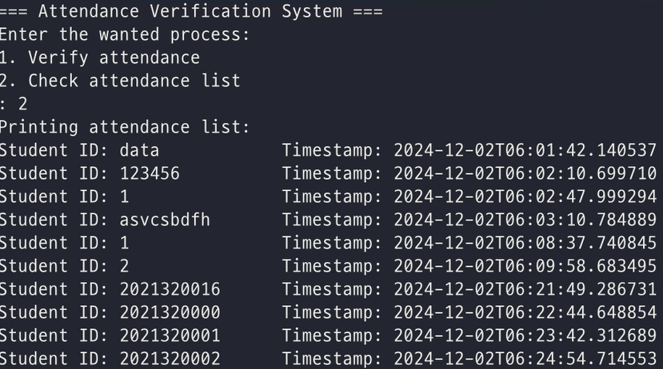
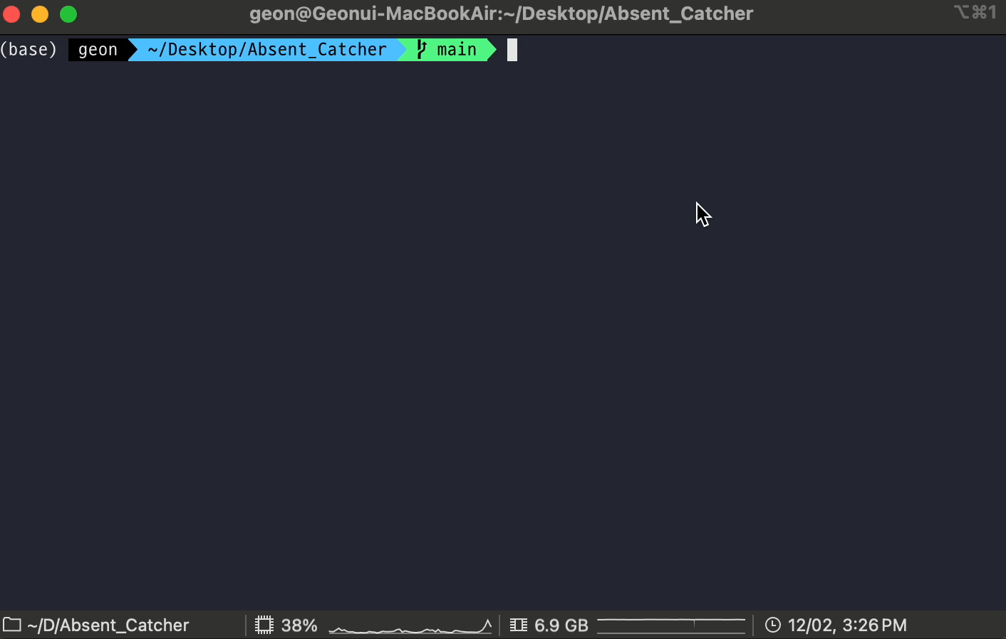
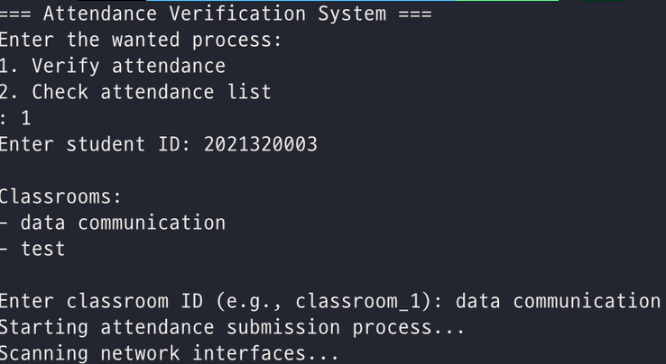
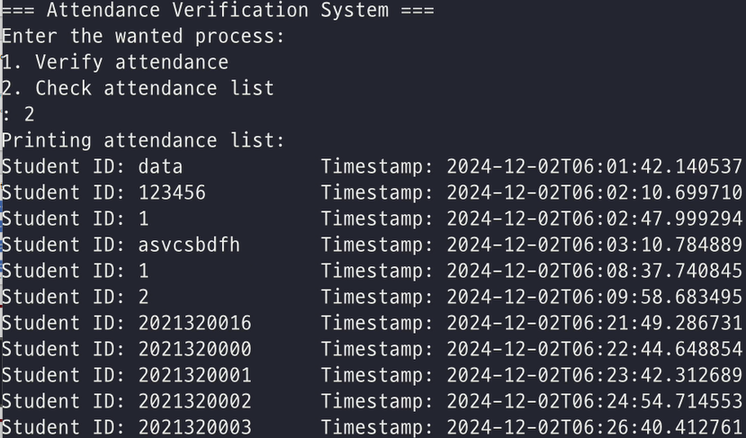
Demo Video
Demo Video

Slide 7


Future Work
Persistent Presence Check
Problem
Student can leave the classroom
during the class
Approach
Capture the packets again
First check is directly sent to the server and verified
The application checks twice more, once every 30 minutes for the remaining hour (in background)
Send the captured packets at the next attendance check
Accuracy of the Location Check
Problem
Packet can be captured
‘near’ the classroom
Approach
Use multiple Aps
Strength of the signals

Slide 8

Thank You
#Question #Answer
Role
Allocation
Presentation
Junhwan Choi
Youmin Kim
Taehee Jeong
Front-end
Back-end
Geon Woo Lim
Chanwoo Park
Dohun Kim
Tae Geon Um
Tommy Tran
Client
Server

